Slide 1
Buck, Boost and Buck-Boost Converter

Slide 2
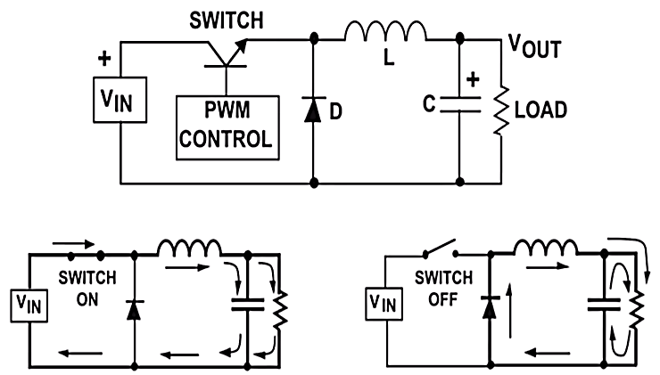
Buck Converter
The most commonly used switching converter is the Buck, which is used to down-convert a DC voltage to a lower DC voltage of the same polarity.
This is essential in systems that use distributed power rails (like 24 V to 48 V), which must be locally converted to ISV, 12V or 5V with very little power loss.

Slide 3

Buck Converter-Working
The input end of the inductor is forced negative in voltage by the decreasing current, eventually reaching the point where the diode is turned on. The inductor current then flows through the load and back through the diode.
The capacitor discharges into the load during the OFF time, contributing to the total current being supplied to the load (the total load current during the switch OFF time is the sum of the inductor and capacitor current).

Slide 4
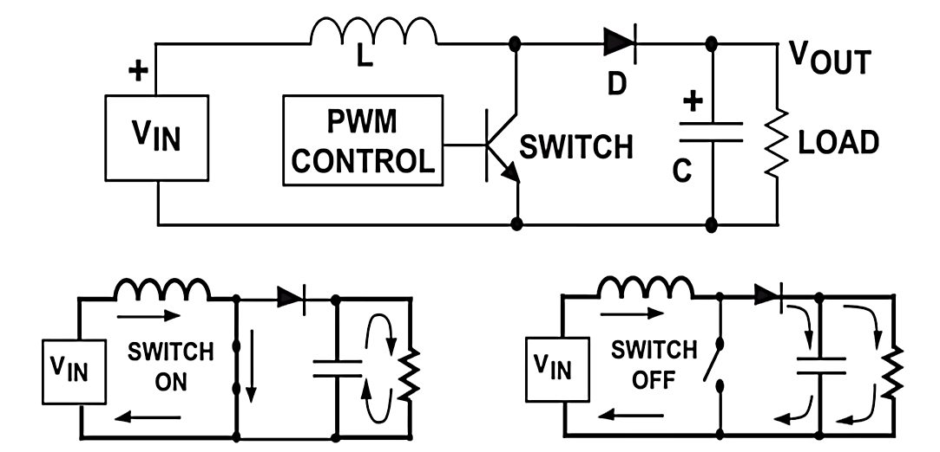
Boost Converter
The Boost regulator takes a DC input voltage and produces a DC output voltage that is higher in value than the input (but of the same polarity).

Slide 5
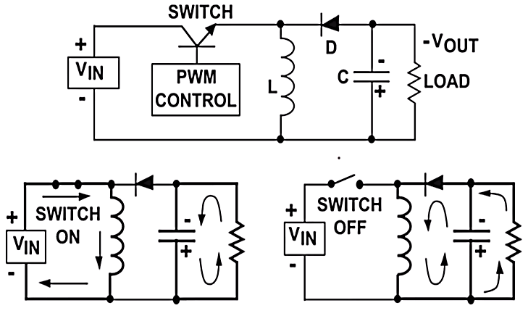
Buck - Boost Converter
The Buck-Boost or Inverting regulator takes a DC input voltage and produces a DC output voltage that is opposite in polarity to the input. The negative output voltage can be either larger or smaller in magnitude than the input voltage.

Slide 6
Buck - Boost Converter-Working
When the switch is on, the input voltage is forced across the inductor, causing an
increasing current flow through it. During the ON time, the discharge of the output
capacitor is the only source of load current.
This requires that the charge lost from the output capacitor during the on time be
replenished during the OFF time.
When the switch turns off, the decreasing current flow in the inductor causes the
voltage at the diode end to swing negative. This action turns on the diode, allowing the
current in the inductor to supply both the output capacitor and the load.
As shown, the load current is supplied by inductor when the switch is off, and by the
output capacitor when the switch is on.

Slide 7
Thank you

